Slide 1
Svm with pca
Anugu Vineeth Reddy
Guru Nanak Institute of Technology
Group 20

Slide 2
SVM(Support Vector Machine)
A support vector machine (SVM) is a supervised machine learning model that uses classification algorithms for two-group classification problems.
Support Vectors are the most extreme data points of one category
Positive Hyperplane
Maximum margin hyperplane
(maximum margin classifier)
Maximum margin
Support Vectors
Negative Hyperplane

Slide 3
SVM(Support Vector Machine)
SVM are generally used for:
Face Detection
HandWriting Detection
Classification of images
Classification of satellite data like SAR data using supervised SVM.
It should be noted that SVM is a Linear Classification algorithm.
The accuracy of the classification model can be checked using Confusion matrix and Accuracy Scores.

Slide 4
PCA(Principal Component Analysis
Principal Component Analysis is a method to project data in a higher dimensional space into a lower dimensional space by maximizing the variance of each dimension.
Dimensionality reduction algorithms are generally useful as visualizing data with a higher dimension is much harder than visualizing lower dimensional data
PCA is mostly used as a tool in exploratory data analysis and for making predictive models.
PCA can be used for:
Noise filtering
Visualization
Feature Extraction
Stock market predictions
Gene data analysis

Slide 5
Problem Given
Create SVM, KNN and SVM with PCA Machine Learning classification models to predict the output of the given data set.
For all the models plot the confusion matrix and print the accuracy score.

Slide 6
Data Set
The given data consists of 2 parameters:
Review
Label
Review is the actual review that we need to work on, this acts as the input variable in our models
Label consists of 0’s or 1’s against each review. 0 indicates a bad review and 1 implies that the review is positive.
And the data set will be “.tsv” file.

Slide 7
Approach used for SVM with PCA model
For SVM with PCA model, the following steps are considered.
Importing the dataset
Implementing General Algorithm
Importing PCA
Finding the best fit for n_estimators
Refitting Input x using after PCA
Splitting the dataset into training and test samples
Classifying the predictors and target
Initializing Support Vector Machine and fitting the training data
Predicting the classes for test set
Comparing the actual classes and predictions
Calculating the accuracy of the predictions

Slide 8
Approach used for SVM with PCA model
The General Algorithm in the step 2 include steps like
Import all the necessary libraries.
Import the dataset which is in the TSV format into pandas data frame.
Removing the quotes
specify the boundary between separate, independent regions in plain text or other data streams. (Delimiting)
Creating Bag of words
Bag of Words are the final list of words that pass through our regular expressions (RE) , Stop words and Stemming.

Slide 9
To enhance the accuracy
To enhance the overall accuracy of the model, few extra steps and alterations were required like:
Creating a new dictionary for the possible “slang words” or possible errors.
Updating the stop words list.
Finding the best ‘n_estimator’ value for the PCA.
Checking various ‘kernel’ of the SVM model.
Changing the test and training size of the data.

Slide 10
Creating a new dictionary for the possible “slang words” or possible errors.
While writing a review people are likely to use slang words or end up making grammatical or spelling mistakes in their sentences.
So I have created a new dictionary with list of possible errors a person might do in their text and what the actual word might be.
Ex: disappointment -> disappointment
Because if the word is important in predicting the output and that word does not pass to the bag of words then the prediction might be flawed.

Slide 11
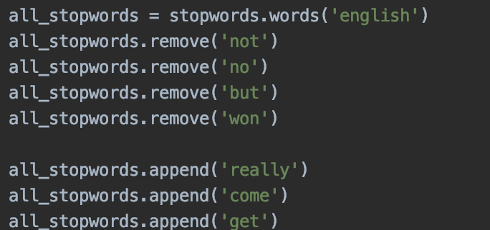
Updating the stop words list.
Sometime the default list of stopwords might contain import words like “no”, “not” and others which might be important part of the prediction.
Ex: I do not love it -> I do love it.
Both the above statements are contradicting and the only difference in the statements is the word ‘not’.
Hence making sure that the right words are present in the stop words list is pretty important.

Slide 12
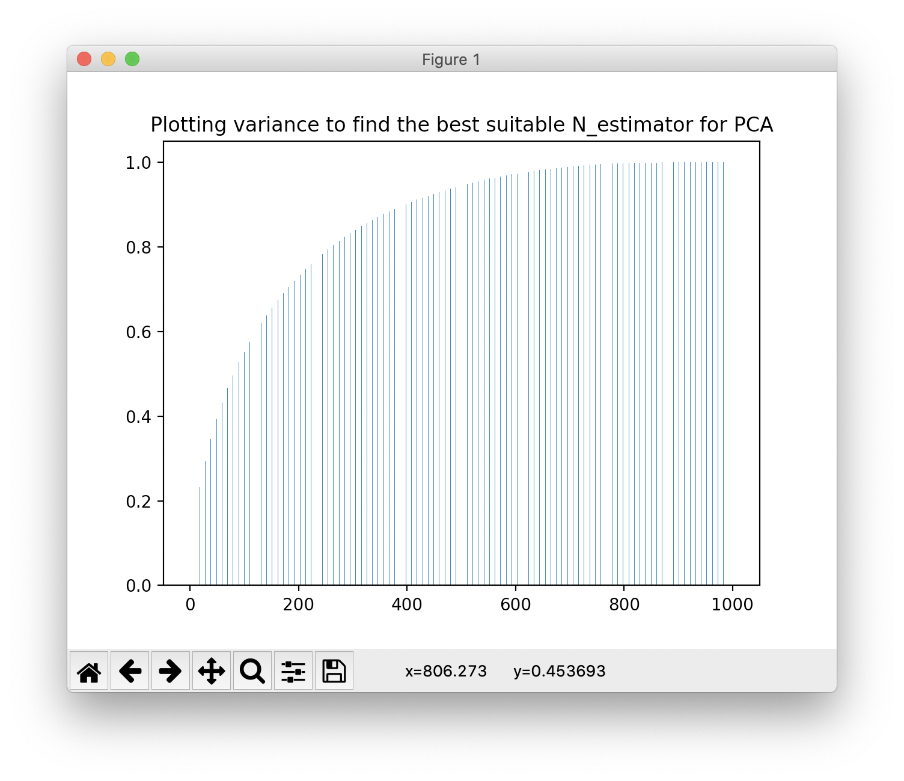
Finding the best ‘n_estimator’ value for the PCA
To find the best n_estimor value we might have to plot the graph of the eigen values
This will help us to understand clearly what value would be the right fit for out given data set.

Slide 13
Checking various ‘kernel’ of the SVM model.
There are various kernels to model a SVM algorithm.
Those include:
Polynomial Kernel(poly),
Gaussian Kernel,
Radial Basis Function (RBF),
Laplace RBF Kernel,
Sigmoid Kernel,
Anove RBF Kernel etc
The best kernel for out dataset turned out to be ‘rbf’.

Slide 14
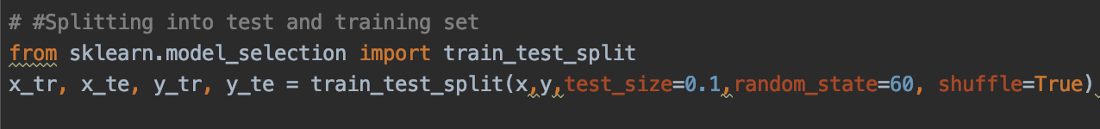
Changing the test and training size of the data.
Generally the most comment training-test size ratio are 70-30 or 80-30.
But because out dataset is huge with nearly 10000 reviews, A test size of 10 would give you a lot of reviews to check the accuracy of the model without overfitting.
Hence in our model, I have used the ratio of 90-10.

Slide 15
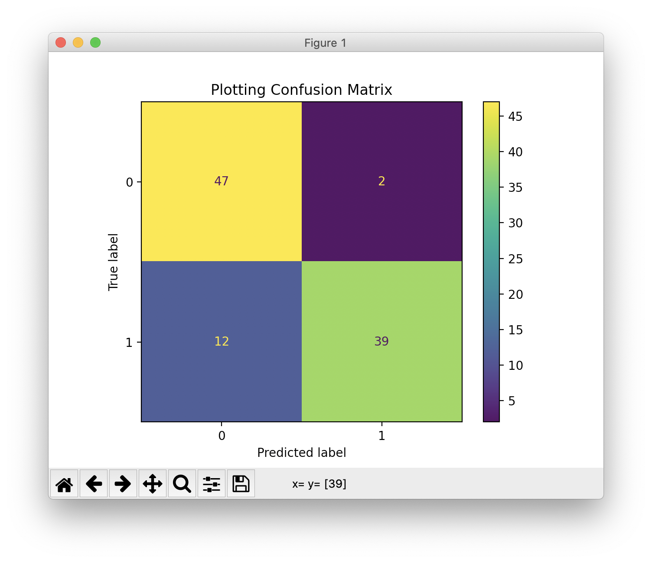
Result.
Finally when I plotted the confusion matrix and have printed the accuracy score of my model, the outputs turned out to be:
Accuracy Score : 86%
Confusion Matrix:

Slide 16
Thank You

